Slide 1

01 – Serene Yoga Studio: Digital Wellness Platform
A feature-rich web app bridging Yoga & Technology
Developers: Sania Siddiqui & Aditya Kumar Dhal

Slide 2


02 – Identifying the Gap in Traditional Yoga Spaces
Manual bookings & limited outreach
No centralized user control system
Needed a scalable platform for yoga learning & scheduling

Slide 3
03 – Our Solution: An Interactive Yoga Web Portal
BOOK, LEARN, EXPLORE FROM A SINGLE PLATFORM
ROLE-BASED DASHBOARDS: ADMIN & USER
REAL-TIME REGISTRATION SYSTEM

Slide 4
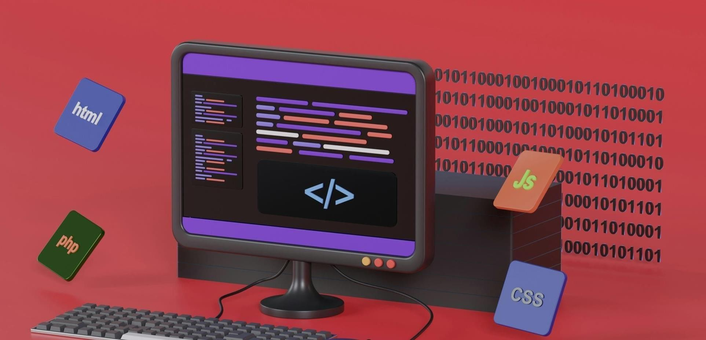
04 – Core Technologies Driving the App
Frontend: HTML5, CSS3, JavaScript (ES6)
Toastify.js – Non-intrusive alerts
Swiper.js – Carousel for hero section
FullCalendar.js – Dynamic class scheduling
localStorage – Persistent client-side data

Slide 5

05 – What’s Inside?
HERO CAROUSEL
INSTRUCTOR PROFILES
CLASS CARDS WITH INFO
EMBEDDED VIDEO SECTION
DASHBOARDS (ADMIN/USER)
ENQUIRY + FEEDBACK + BLOG SECTIONS

Slide 6



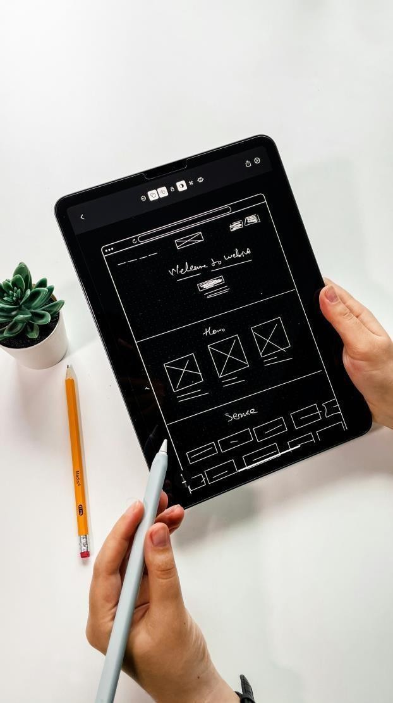
06 – Sania Siddiqui: UI/UX Frontliner
Designed the complete frontend layout
Used CSS Grid/Flexbox for responsiveness
Developed: Home, About, Classes, Videos, Blog
Integrated Swiper.js & FullCalendar visually

Slide 7

07 – Aditya Kumar Dhal: Functionality Architect
Built login/signup/auth logic
Designed role-based dynamic dashboards
Managed data flow using JSON in localStorage
Implemented form validation, toasts, and modular JS logic

Slide 8
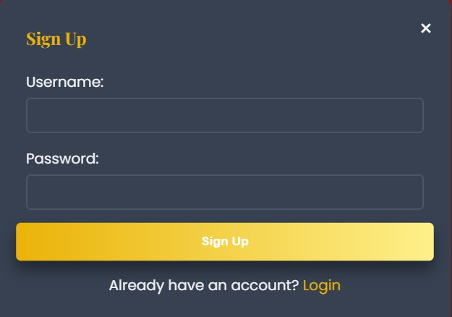
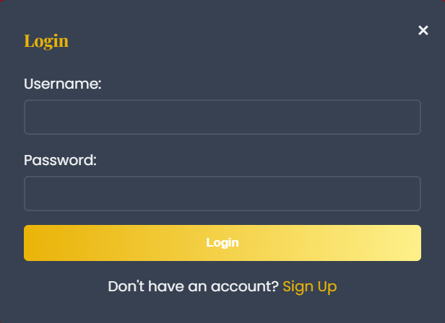
08 – Login &
Signup Flow
Modal-based interface
Switchable forms with basic validation
Secure role-based access: Admin/User

Slide 9
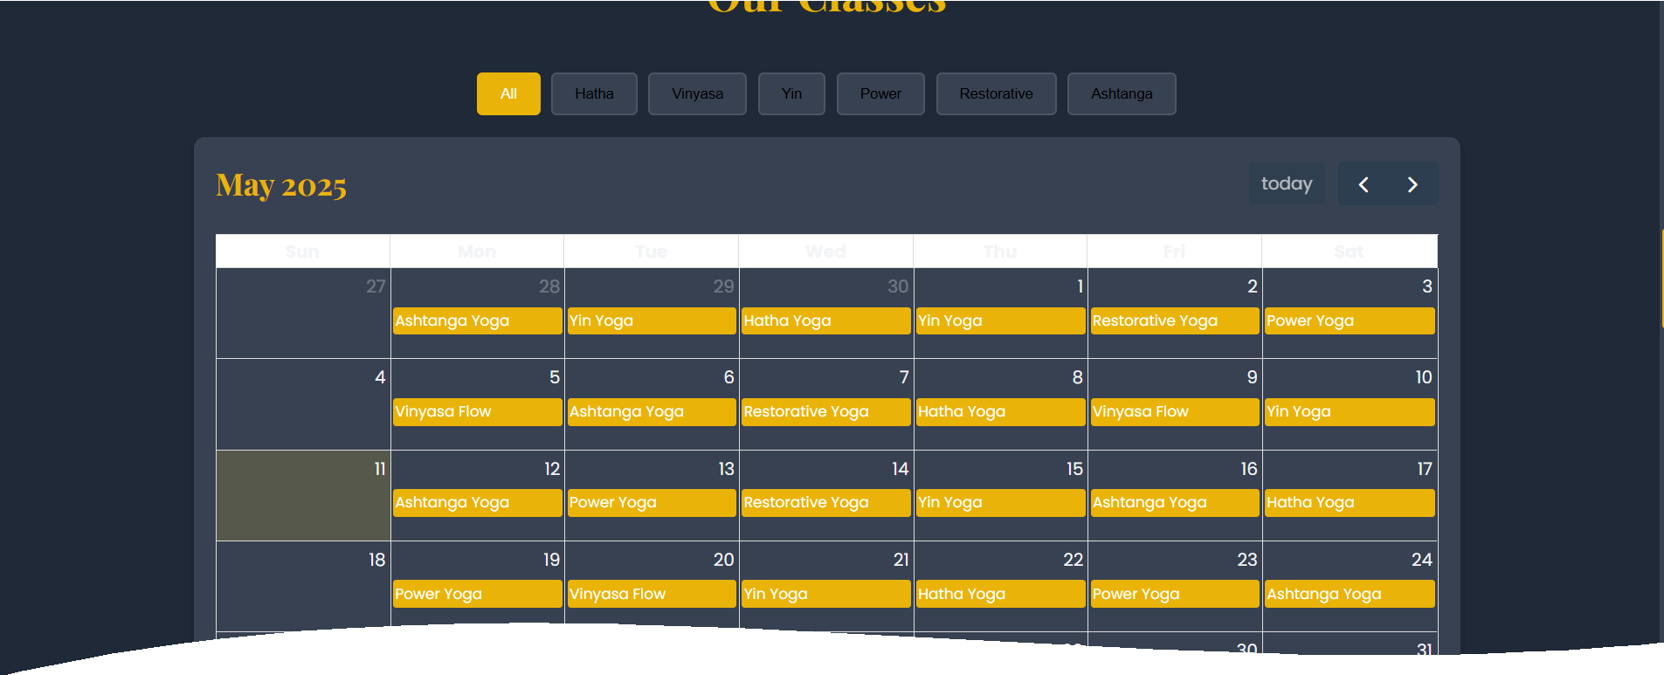
09 – Explore
Classes & Schedule
6 Yoga styles – Each with description, level, instructor
Filters + calendar view (FullCalendar)
Date/time selection for registration

Slide 10

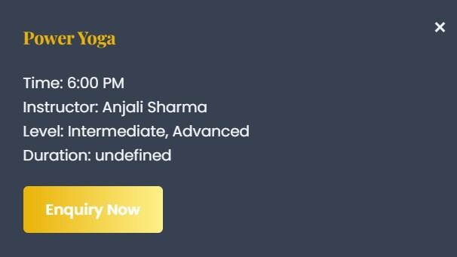

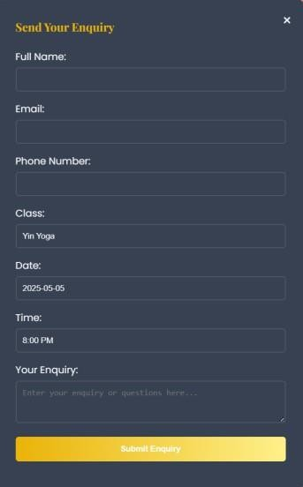
10- Interactive Yoga Calendar with Instant Enquiry
Integrated with FullCalendar.js for real- time scheduling.
Filter yoga classes by style (e.g., Hatha, Vinyasa).
On clicking a class, users see details and can click 'Enquiry'.
Clicking 'Enquiry' opens a popup form without page reload.
User-friendly UX encourages direct interaction and engagement.

Slide 11

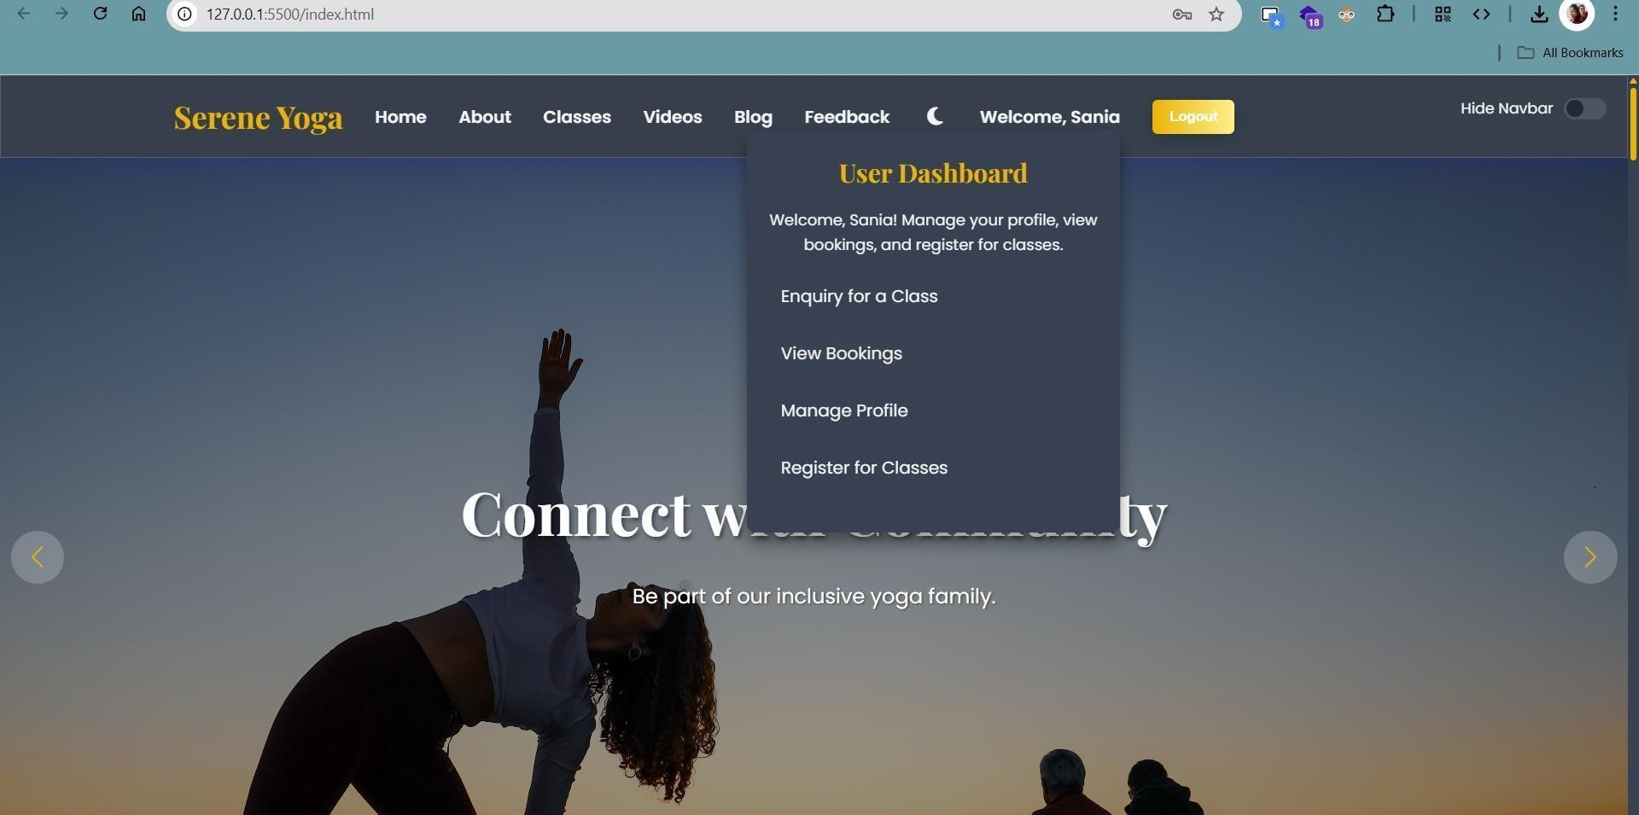
11 – User Dashboard Experience
Profile Management
Booking Enquiry
View Class Registrations

Slide 12
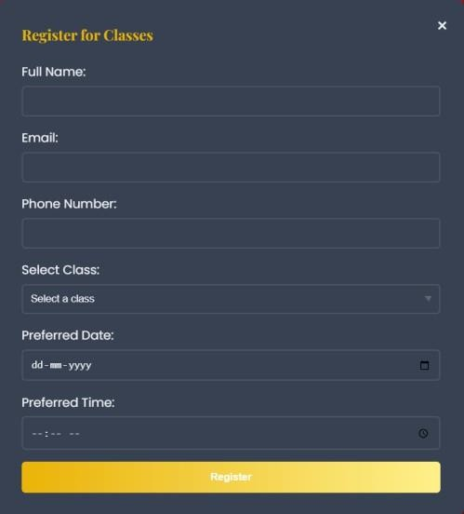
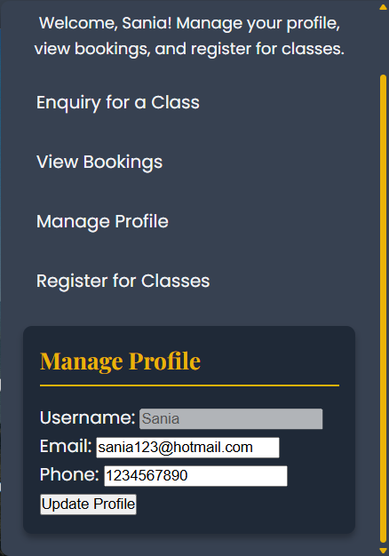
12 - One Dashboard. Total Control
Book classes via a simple registration modal.
Submit class enquiries directly from the dashboard or calendar.
View personal bookings and registration history.
Edit profile: update email, phone, and personal info.
Intuitive UI for seamless navigation and control.

Slide 13
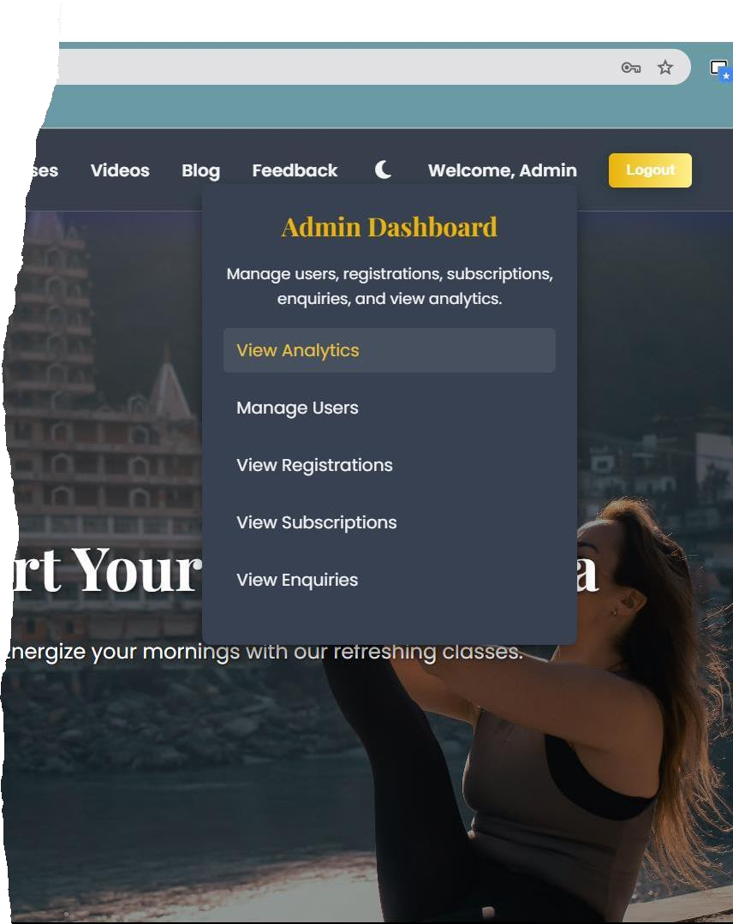
13 – Admin Dashboard: Control Center
Manage users & view analytics
Insights: Total bookings, popular class, subscriptions
Real-time data rendered from localStorage

Slide 14
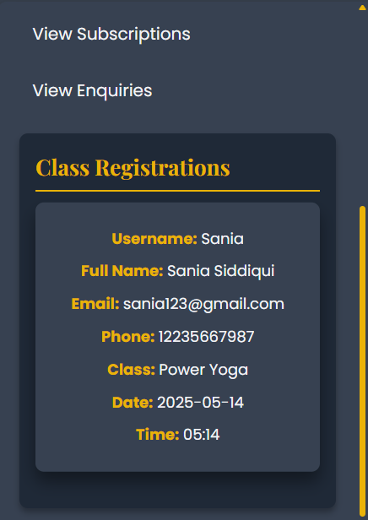
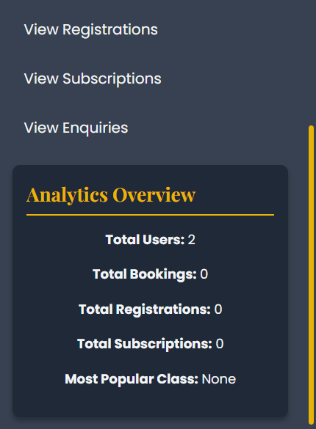
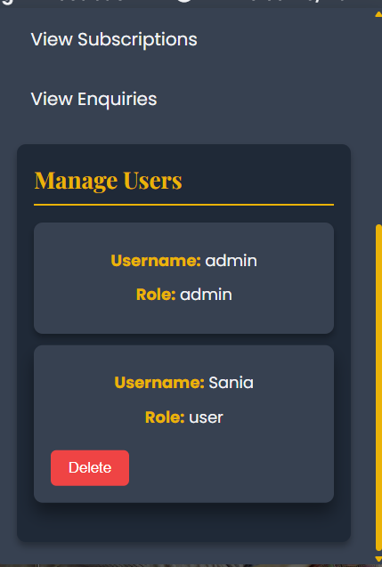
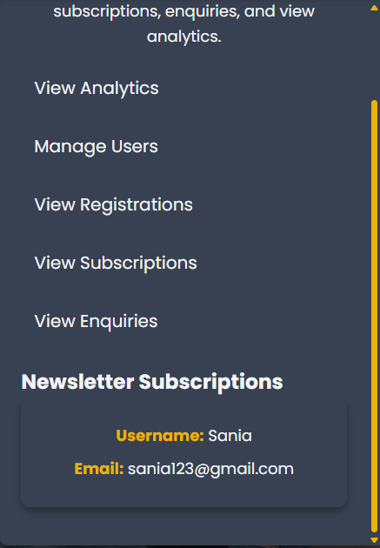
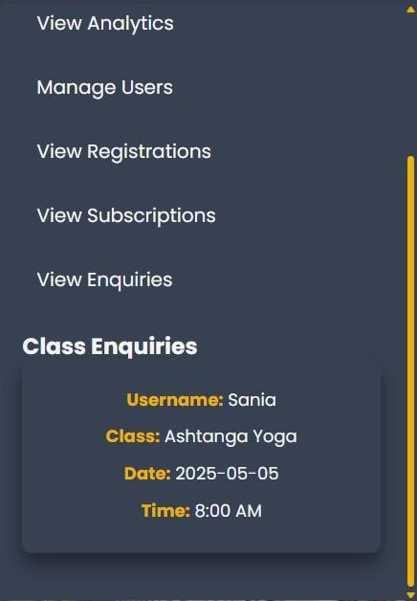
14 - Command Center for Yoga Operations
Powered by localStorage to simulate backend data operations.
View analytics: total users, bookings, registrations, and popular classes.
Manage user accounts – view and delete users.
Access all class registrations and newsletter subscriptions.
Monitor and respond to enquiries submitted by users.

Slide 15
15 – Handling Data Without a Backend
Stores Users, Bookings, Registrations, Subscriptions
Used localStorage to simulate a backend
Read/write operations using JS

Slide 16

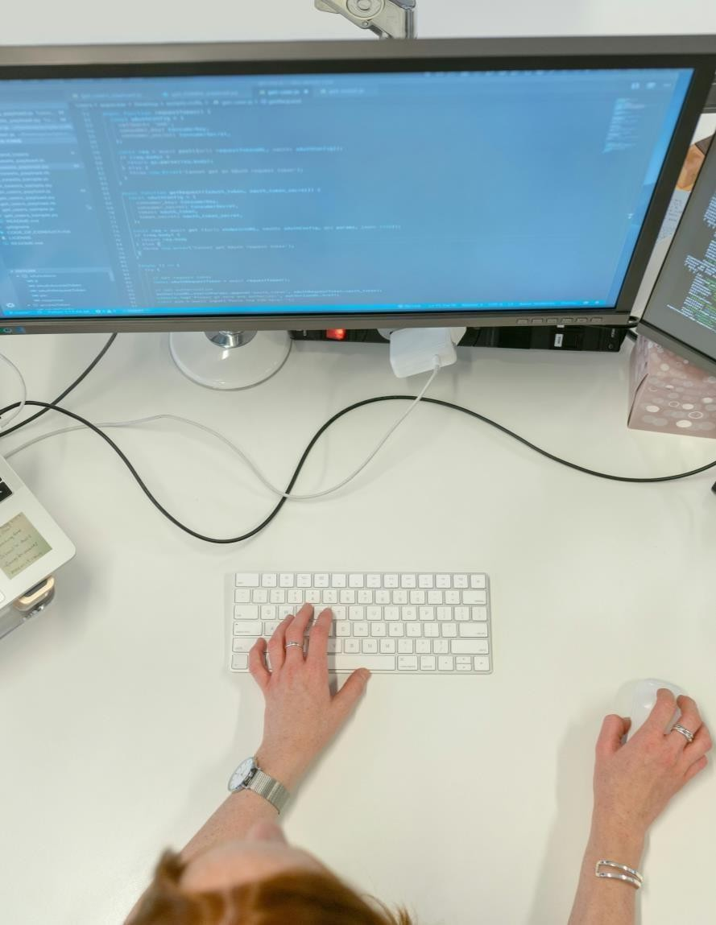
16 – Challenges We Conquered
Dynamic modal switching
Managing real-time role-based UI
Syncing date/time with calendar & form inputs
Consistent visual theme across
dark/light modes

Slide 17


17 – Our Wins & Takeaways
Learned component modularity
Enhanced debugging & error- handling mindset
Deep dive into real- world JS usage
Practiced collaborative versioning

Slide 18


18 – Developers in Sync
Sania Siddiqui – UI/UX Lead (HTML, CSS,
Swiper, Calendar Styling)
Aditya Kumar Dhal – JS & Logic Developer
(Toastify, Form Handling, Storage)

Slide 19

19 – Thank You & Q/A
We appreciate your time
Let’s talk more about tech, design, and logic
Serene Yoga Studio: Where Calm Meets Code

